Slide 1
Splash Screen

Slide 2
Lesson Menu
Five-Minute Check (over Lesson 3–3)
Then/Now
New Vocabulary
Key Concept: Inverse Property of Multiplication
Example 1: Find Multiplicative Inverses
Key Concept: Dividing Fractions
Example 2: Divide by a Fraction or Whole Number
Example 3: Divide by a Mixed Number
Example 4: Standardized Test Example
Example 5: Divide Algebraic Fractions

Slide 3
5-Minute Check 1
A.
B.
C.
D.

Slide 4
5-Minute Check 2
A.
B.
C.
D.

Slide 5
5-Minute Check 3
A.
B.
C.
D.

Slide 6
5-Minute Check 4
A. 2
B.
C. 6
D.

Slide 7
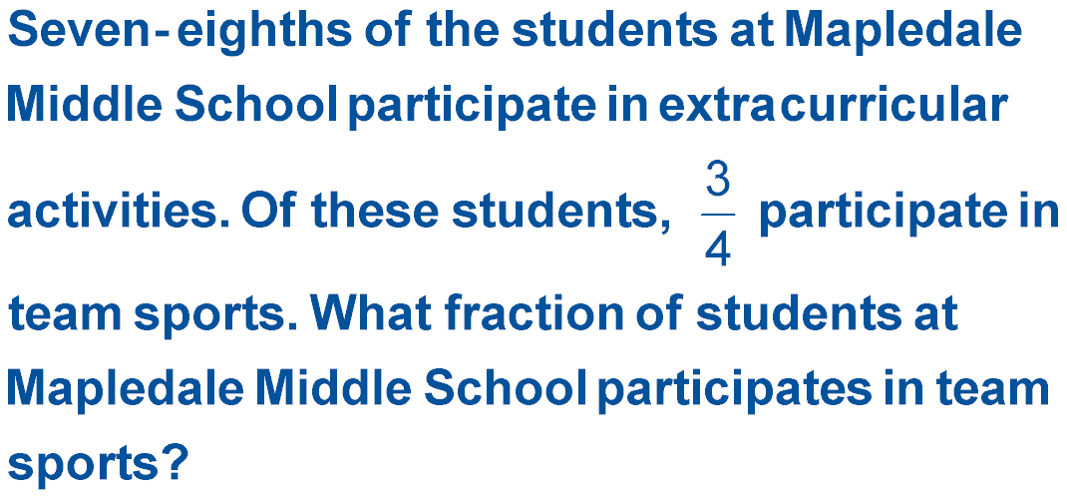
5-Minute Check 5
A. B.
C. D.

Slide 8
Then/Now
You have already divided positive fractions and multiplied rational numbers. (Lesson 3–3)
Divide positive and negative fractions using multiplicative inverses.
Divide algebraic fractions.

Slide 9
Vocabulary
multiplicative inverse
reciprocal

Slide 10
Concept

Slide 11
Example 1
Find Multiplicative Inverses
A.
The product is 1.
Answer:

Slide 12
Example 1
Find Multiplicative Inverses
B.

Slide 13
Example 1
A.
A.
B.
C.
D.

Slide 14
Example 1
A.
B.
C.
D.

Slide 15
Concept

Slide 16
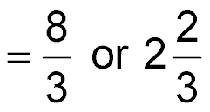
Example 2
Divide by a Fraction or Whole Number
A. Find . Write in simplest form.
Divide by the GCF, 5.
Simplify.
Answer:

Slide 17
Example 2
Divide by a Fraction or Whole Number
B. Find . Write in simplest form.
Write 3 as .
Multiply.
Answer:

Slide 18
Example 2A
A.
B.
C.
D.

Slide 19
Example 2B
A.
B.
C.
D.

Slide 20
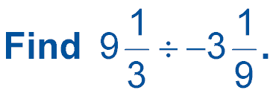
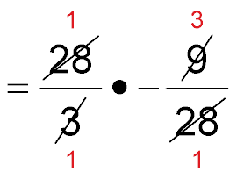
Example 3
Divide by a Mixed Number
Rename the mixed numbers as improper fractions.
Divide out common factors.

Slide 21
Example 3
Divide by a Mixed Number
Simplify.
Answer: –3

Slide 22
Example 3
A. –3
B. –2
C.
D.

Slide 23
Example 4
Read the Test Item
You need to find the number of gallons needed.

Slide 24
Example 4
Solve the Test Item

Slide 25
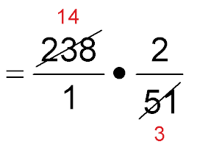
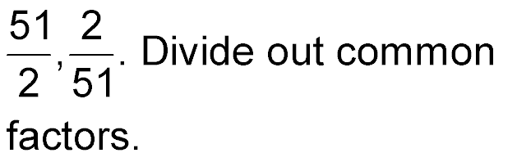
Example 4
Answer: So, the correct answer is B.

Slide 26
Example 4
A. 20 glasses
B.
C.
D. 30 glasses

Slide 27
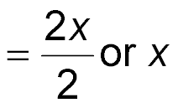
Example 5
Divide Algebraic Fractions
Divide out common factors.
Simplify.
Answer:

Slide 28
Example 5
A.
B.
C.
D.

Slide 29
End of the Lesson

